Slide 1
SOLID Principles of OOD
Chris Gibson
Sameeri Marryboyina

Slide 2


Slide 3
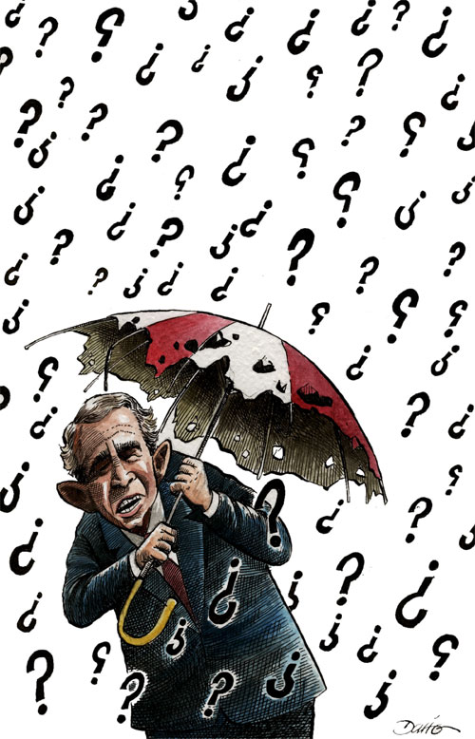
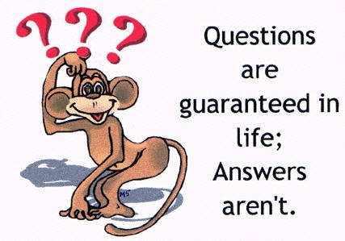

Slide 4
EPP Motivation

Slide 5
Engineering Philosophy
Beautiful, Maintainable Code
We want to “Care” about our code

Slide 6
Norman Rockstars follow
Kaizen
Yesterday we have code that works
Today we want to improve it

Slide 7
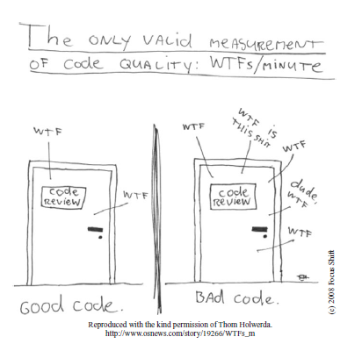
Clean Code

Slide 8
SOLID Design Principles

Slide 9

The One CONSTANT in Software development

Slide 10
How does our software respond to CHANGE?

Slide 11
Code Smells
Refactoring – Improving the design of existing code [Martin Fowler]
Clean Code : A handbook of Agile Software Craftsmanship [Bob Martin]
Catalog of smells

Slide 12
Design Smells
Rigidity
Fragility
Viscosity
Immobility

Slide 13
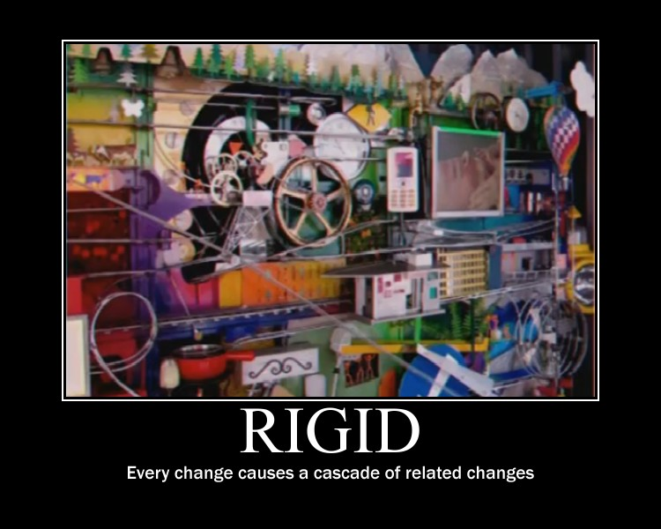

Slide 14
RIGIDITY
Rigidity is the tendency for software to be difficult to change, even in simple ways. A design is rigid if a single change causes a cascade of subsequent changes in dependent modules. The more modules that must be changed, the more rigid the design.

Slide 15
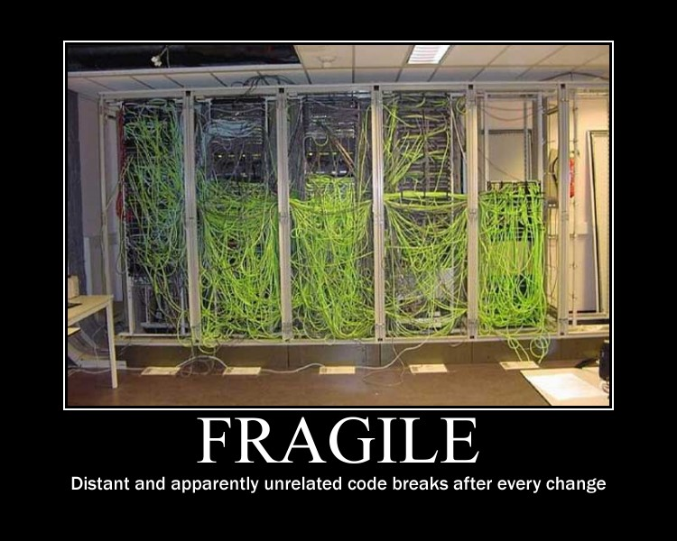

Slide 16
Fragility
Fragility is the tendency of a program to break in many places when a single change is made. Often, the new problems are in areas that have no conceptual relationship with the area that was changed. Fixing those problems leads to even more problems, and the development team begins to resemble a dog chasing its tail.

Slide 17
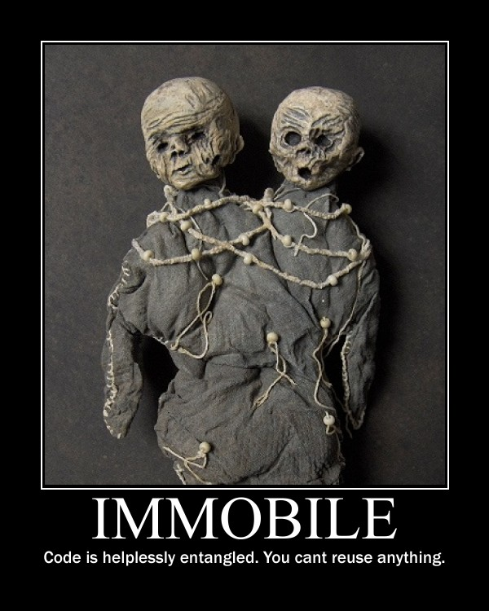

Slide 18
IMMOBILITY
A design is immobile when it contains parts that could be useful in other systems, but the effort and risk involved with separating those parts from the original system are too great. This is an unfortunate but very common occurrence.

Slide 19
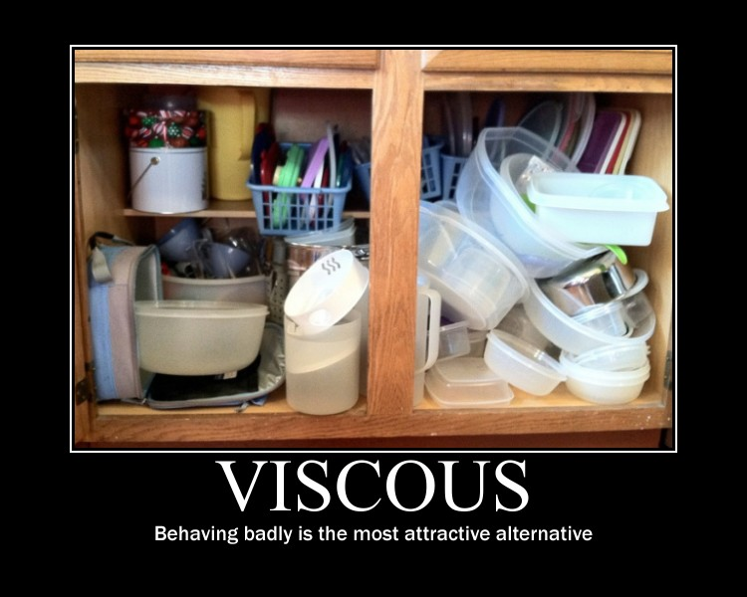

Slide 20
VISCOSITY
A viscous project is one in which the design of the software is difficult to preserve. Friction develops and slows us down. We want to create systems and project environments that make it easy to preserve and improve the
design.

Slide 21
Other OO Developers
Have committed the same mistakes
Have learnt from those mistakes
Have specified some GUIDELINES
We can choose to follow or not!
If we choose to follow, we have to understand the problems and where they apply.
If we encounter the same issues, we can meditate on these guidelines and apply them.

Slide 22
So, what are SOLID principles about?
Better question would be : What problems are they trying to solve?
They are trying to solve a specific set of problems, namely

Slide 23
DEPENDENCY MANAGEMENT ISSUES

Slide 24
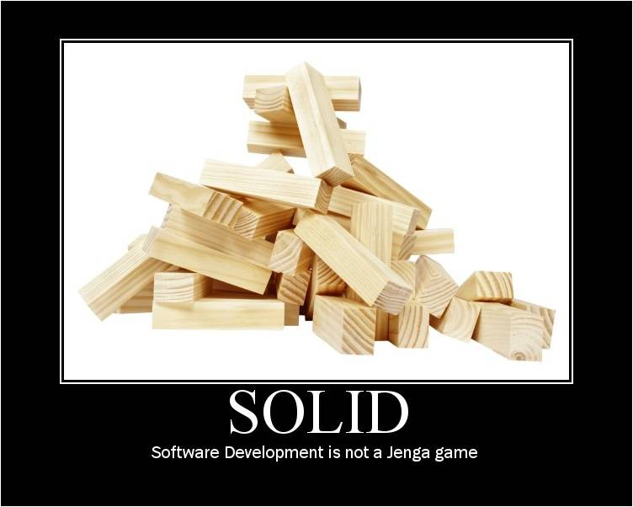

Slide 25
SOLID principles of Object Oriented Design
Single Responsibility Principle
Open/Closed Principle
Liskov Substitution Principle
Interface Segregation Principle
Dependency Inversion Principle

Slide 26
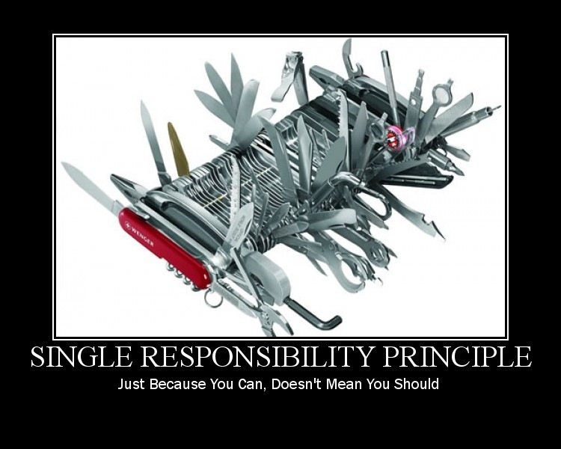

Slide 28
Talk is cheap, show me the code - Linus Torvalds

Slide 29
Reflect on SRP
A CLASS SHOULD HAVE ONE AND ONLY ONE RESPONSIBILITY.
THERE SHOULD NEVER BE MORE THAN ONE REASON FOR A CLASS TO CHANGE.

Slide 30
SRP
Why is it important to separate two responsibilities into separate classes?
Because each responsibility is an axis of change.
When the requirements change, that change will be manifest through a change in responsibility amongst the classes. If a class assumes more than one responsibility, then there will be more than one reason for it to
change.
If a class has more then one responsibility, then the responsibilities become coupled.
Changes to one responsibility may impair or inhibit the class’ ability to meet the others.
This kind of coupling leads to fragile designs that break in unexpected ways when changed.

Slide 31
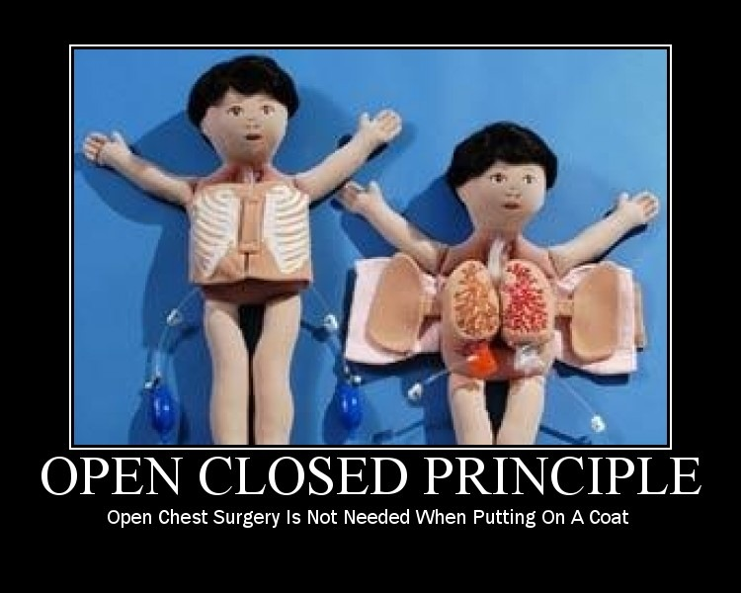

Slide 32
Reflect on OCP
SOFTWARE ENTITIES (CLASSES, MODULES, FUNCTIONS, ETC.) SHOULD BE OPEN FOR EXTENSION, BUT CLOSED FOR MODIFICATION.

Slide 33
OCP
Open to Extension : New Behavior can be added in the future
Closed to Modification: Changes to existing code is not required.

Slide 34
OCP
1. OCP is at the heart of Object Oriented design
2. Conformance to OCP yields the greatest benefits of OOD, reusability & maintainability
3. Key to OCP is programming to abstractions.
4. Do not depend on implementations, depend on abstractions.
5. 100 % Conformance to OCP is not possible. There might be a requirement that may render our code not closed.
6. Since closure cannot be complete, it should be strategic.
7. Developer must choose what changes the code can be closed to.
8. Experience would help a developer to make choices and design code for the most probable causes of change.

Slide 35
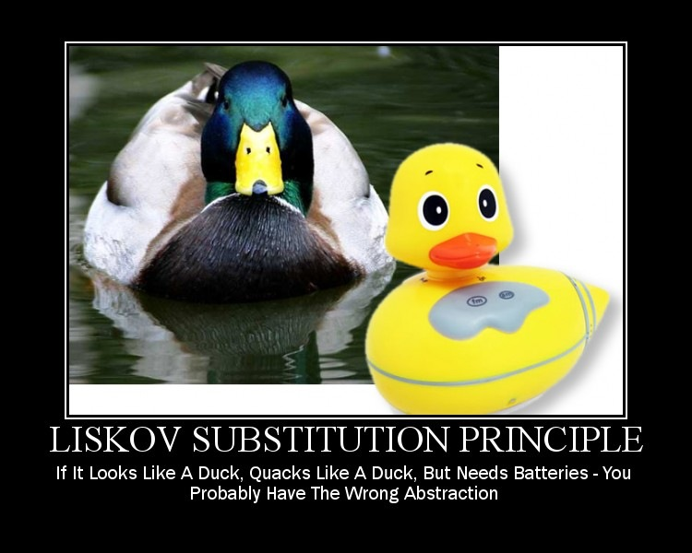

Slide 36
Reflect on LSP
FUNCTIONS THAT USE POINTERS OR REFERENCES TO BASE CLASSES MUST BE ABLE TO USE OBJECTS OF DERIVED CLASSES
WITHOUT KNOWING IT.

Slide 37
LSP
The above is a paraphrase of the Liskov Substitution Principle (LSP). Barbara Liskov first
wrote it as follows :
If for each object o1 of type S there is an object o2 of type T such that for all
programs P defined in terms of T, the behavior of P is unchanged when o1 is
substituted for o2 then S is a subtype of T.

Slide 38
LSP
Sub-types must be substitutable for their base types.
Named after Barbara Liskov, who gave the principle in 1988.
Substitutability
Calling code must not know the difference between a derived type and a base type.
Child classes should not remove base class behavior.
Native OOP: "IS-A" relationship
LSP : "IS-SUBSTITUTABLE=FOR“
LSP surfaces the undesired behavior problems in subtypes caused due to inheritance

Slide 39
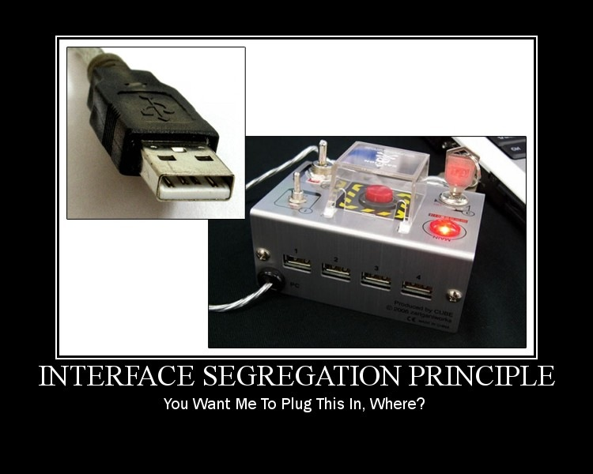

Slide 40
Reflect on ISP
CLIENTS SHOULD NOT BE FORCED TO DEPEND UPON INTERFACES THAT THEY DO NOT USE.

Slide 41
ISP
Fat/Polluted interfaces
Classes that have “fat” interfaces are classes whose interfaces are not cohesive.
Let the client drive the interface.
In other words, the interfaces of the class can be broken up into groups of member functions. Each
group serves a different set of clients.
Thus some clients use one group of member functions,
and other clients use the other groups.
The ISP acknowledges that there are objects that require non-cohesive interfaces;
however it suggests that clients should not know about them as a single class. Instead, clients
should know about abstract base classes that have cohesive interfaces. Some languages
refer to these abstract base classes as “interfaces”, “protocols” or “signatures”.

Slide 42
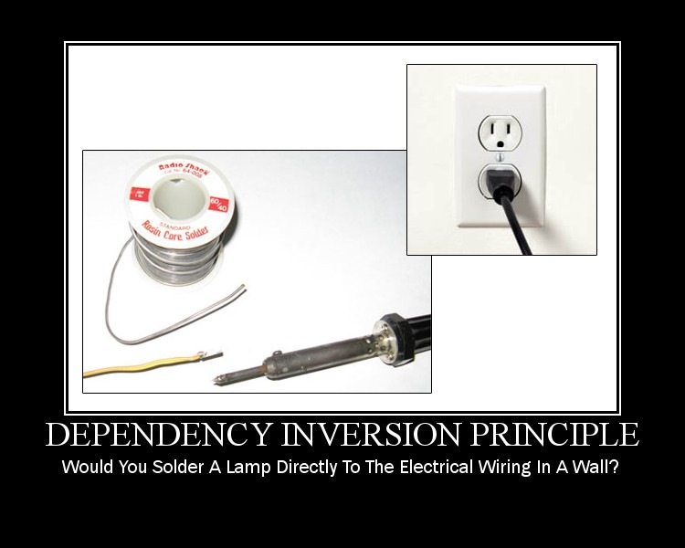

Slide 43
Reflect on DIP
A. HIGH LEVEL MODULES SHOULD NOT DEPEND UPON LOW LEVEL MODULES. BOTH SHOULD DEPEND UPON ABSTRACTIONS.
B. ABSTRACTIONS SHOULD NOT DEPEND UPON DETAILS. DETAILS SHOULD DEPEND UPON ABSTRACTIONS.

Slide 45
Other design smells & principles
Needless Repetition : DRY
Complex/Over design : YAGNI, KISS

Slide 46
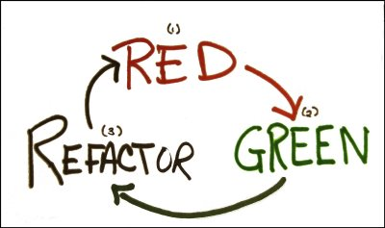
When to apply SOLID Design Principles
TDD presents us an opportunity

Slide 47
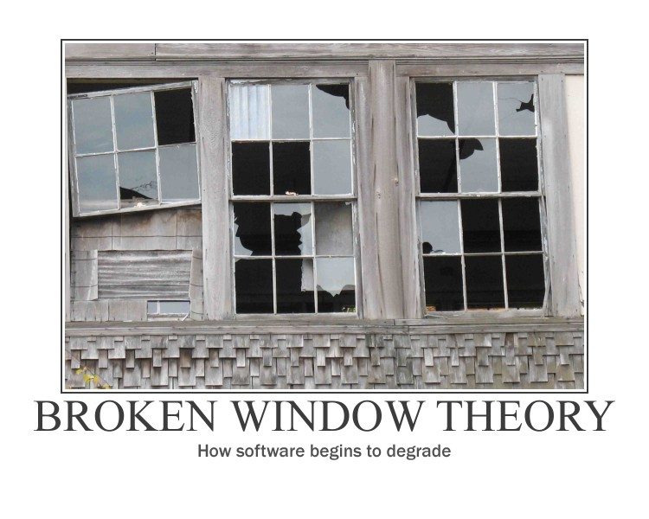

Slide 48
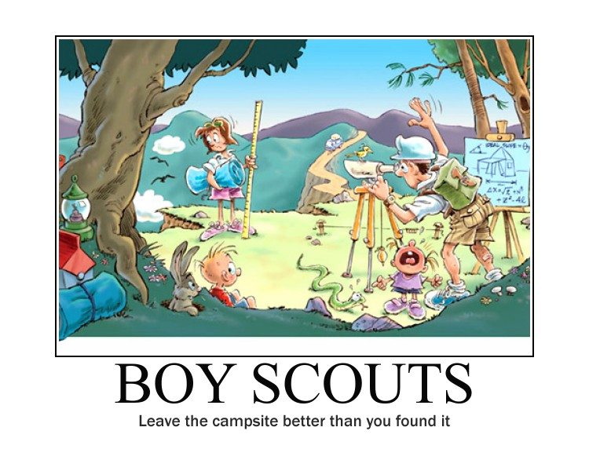

Slide 49
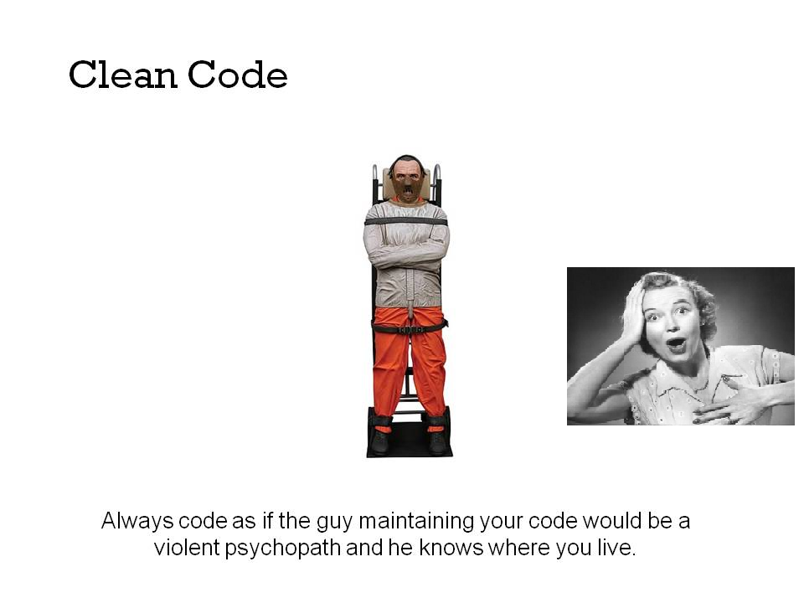

Slide 50
What Next?

Slide 51

Mediate on these principles

Slide 52
For us, its constant learning
Design Patterns
Refactoring to Patterns
Architectural Patterns
Patterns in JavaScript

Slide 53
References

